Slide 1
Marginalized Kernels applied to Biological Sequences

Slide 2
Synopsis
What are biological sequences and how can their similarity be measured?
What are the concepts involved?
Count Kernels
Count Kernel (CK1)
2nd Order Count Kernel (CK2)
Joint Count Kernels and Hidden Markov Models
Marginalized Count Kernel (MCK1)
2nd Order Marginalized Count Kernel (MCK2)
Fischer Kernel
How are these kernels similar? Where do they differ?
What are the cons to the Fischer Kernel?
How well did the kernels perform and what direction can we take moving forward?

Slide 3
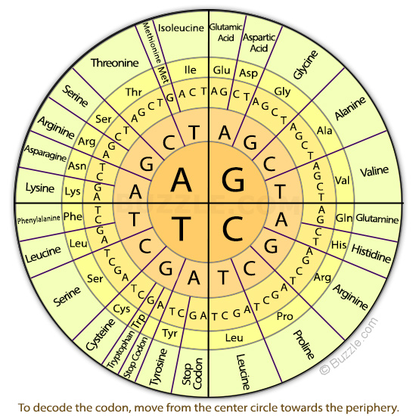
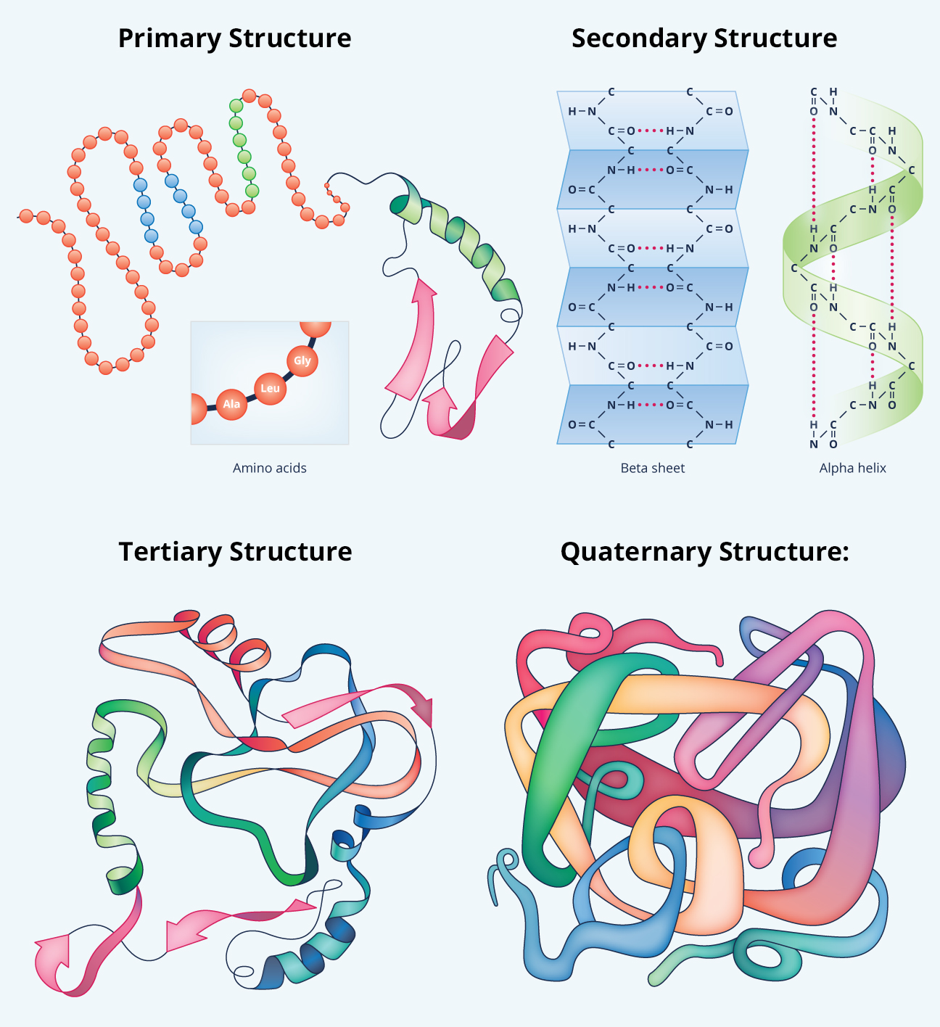
Biological Sequences
DNA sequences (genes, regions, genomes…) with an alphabet = {A,C,G,T} and RNA sequences with alphabet = {A,C,G,U}.
Protein sequences with an alphabet of 20 amino acids = {Ala, Cys, Asp,…}.
DNA and protein sequences are inextricably linked. The DNA alphabet of just four letters spells out the words for amino acids which in turn forms the lexicon of proteins, and thus ultimately, life:

Slide 4
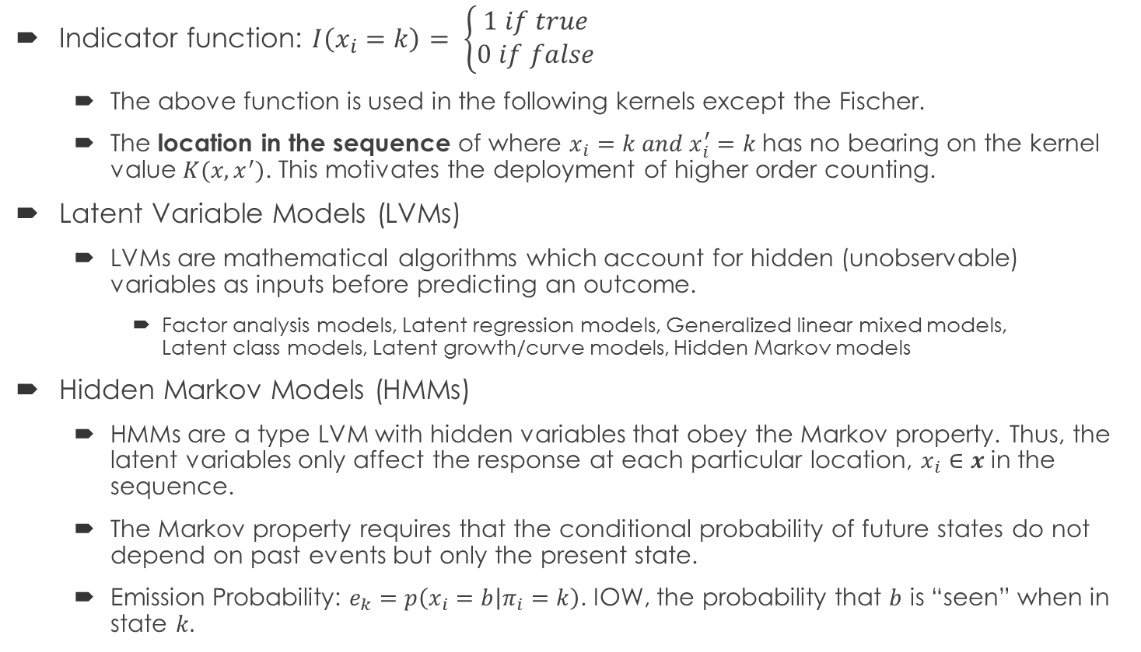
Concepts
Indicator function: $I\left(x_{i}=k\right)= \left\{\begin{aligned}1 if true \\ 0 if false\end{aligned}\right.$
The above function is used in the following kernels except the Fischer.
The location in the sequence of where $x_{i}=k and x_{i}^{′}=k$ has no bearing on the kernel value $K(x,x^{′})$. This motivates the deployment of higher order counting.
Latent Variable Models (LVMs)
LVMs are mathematical algorithms which account for hidden (unobservable) variables as inputs before predicting an outcome.
Factor analysis models, Latent regression models, Generalized linear mixed models, Latent class models, Latent growth/curve models, Hidden Markov models
Hidden Markov Models (HMMs)
HMMs are a type LVM with hidden variables that obey the Markov property. Thus, the latent variables only affect the response at each particular location, $x_{i}∈x$ in the sequence.
The Markov property requires that the conditional probability of future states do not depend on past events but only the present state.
Emission Probability: $e_{k}=p\left(x_{i}=b | π_{i}=k\right)$. IOW, the probability that $b$ is “seen” when in state $k.$

Slide 5
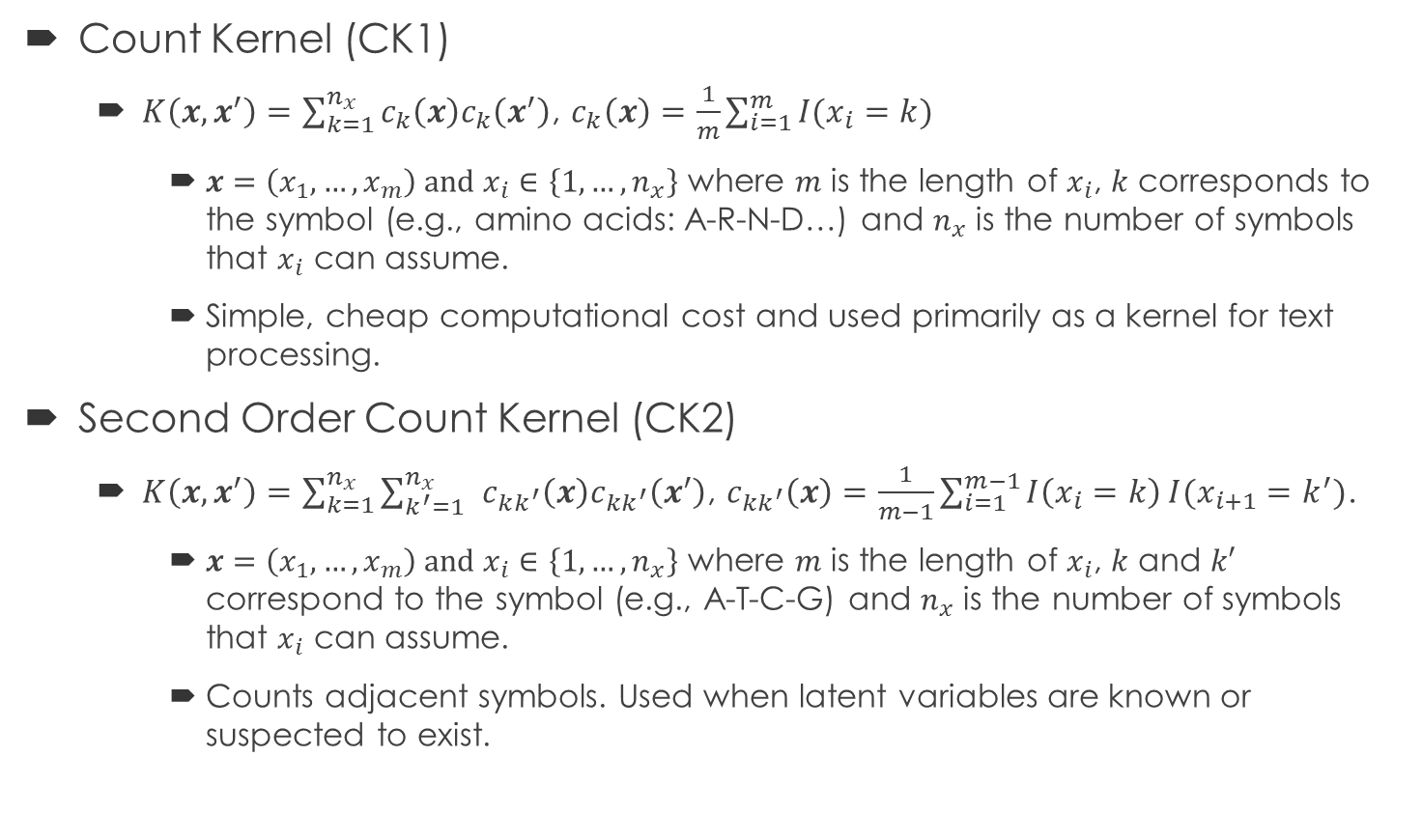
Kernels: Count Kernels
Count Kernel (CK1)
$K\left(x,x^{′}\right)=\sum_{k=1}^{n_{x}}{c_{k}\left(x\right)c_{k}\left(x^{′}\right)}$, $c_{k}\left(x\right)=\frac{1}{m}\sum_{i=1}^{m}{I(x_{i}=k)}$
$x=\left(x_{1}, …,x_{m}\right) and x_{i}∈\left\{1,…,n_{x}\right\}$ where $m$ is the length of $x_{i}$, $k$ corresponds to the symbol (e.g., amino acids: A-R-N-D…) and $n_{x}$ is the number of symbols that $x_{i}$ can assume.
Simple, cheap computational cost and used primarily as a kernel for text processing.
Second Order Count Kernel (CK2)
$K\left(x,x^{′}\right)=\sum_{k=1}^{n_{x}}{\sum_{k^{′}=1}^{n_{x}}{ }c_{kk^{′}}\left(x\right)c_{kk^{′}}\left(x^{′}\right)}$, $c_{kk^{′}}\left(x\right)=\frac{1}{m−1}\sum_{i=1}^{m−1}{I\left(x_{i}=k\right)}I(x_{i+1}=k^{′})$.
$x=\left(x_{1}, …,x_{m}\right) and x_{i}∈\left\{1,…,n_{x}\right\}$ where $m$ is the length of $x_{i}$, $k$ and $k′$ correspond to the symbol (e.g., A-T-C-G) and $n_{x}$ is the number of symbols that $x_{i}$ can assume.
Counts adjacent symbols. Used when latent variables are known or suspected to exist.

Slide 6
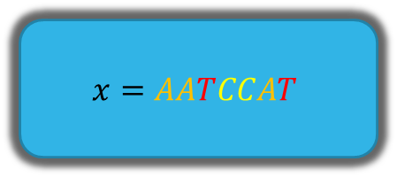
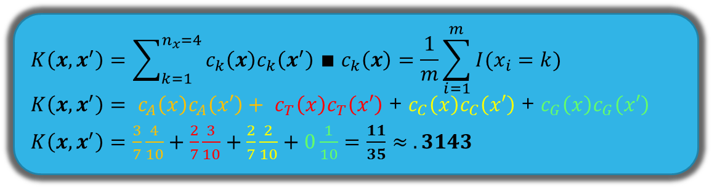
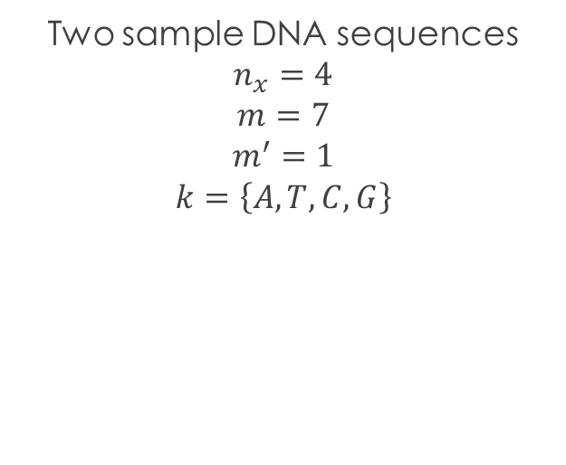
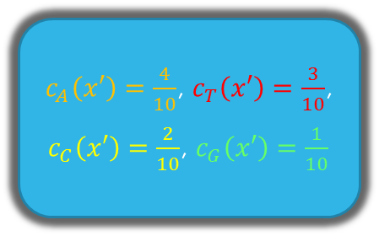
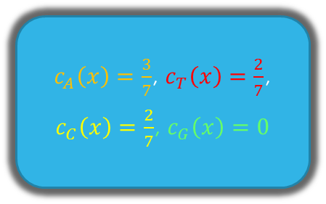
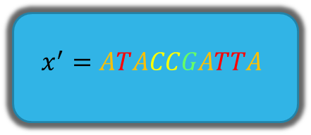
CK1 Exemplified
Two sample DNA sequences
$$n_{x}=4$$
$$m=7$$
$$m^{′}=1$$
$$k=\left\{A, T, C, G\right\}$$
$$x=AATCCAT$$
$$x^{′}=ATACCGATTA$$
$c_{A}\left(x\right)=\frac{3}{7}$, $c_{T}\left(x\right)=\frac{2}{7}$,
$c_{C}\left(x\right)=\frac{2}{7}$, $c_{G}\left(x\right)=0$
$c_{A}\left(x′\right)=\frac{4}{10}$, $c_{T}\left(x′\right)=\frac{3}{10}$,
$c_{C}\left(x′\right)=\frac{2}{10}$, $c_{G}\left(x′\right)=\frac{1}{10}$
$$K\left(x,x^{′}\right)=\sum_{k=1}^{n_{x}=4}{c_{k}\left(x\right)c_{k}\left(x^{′}\right) ∎ c_{k}\left(x\right)=\frac{1}{m}\sum_{i=1}^{m}{I(x_{i}=k)}}$$ $K\left(x,x^{′}\right)= c_{A}\left(x\right)c_{A}\left(x′\right)+ c_{T}\left(x\right)c_{T}\left(x′\right)$ + $c_{C}\left(x\right)c_{C}\left(x′\right)$ + $c_{G}\left(x\right)c_{G}\left(x′\right)$
$K\left(x,x^{′}\right)=$ $\frac{3}{7}\frac{4}{10}+\frac{2}{7}\frac{3}{10}+\frac{2}{7}\frac{2}{10}+0\frac{1}{10}=$ $\frac{11}{35}$ $≈ .3143$

Slide 7
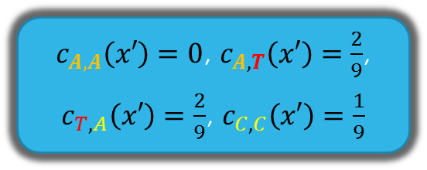

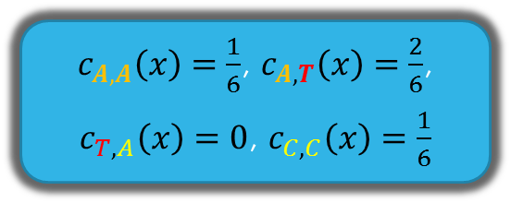
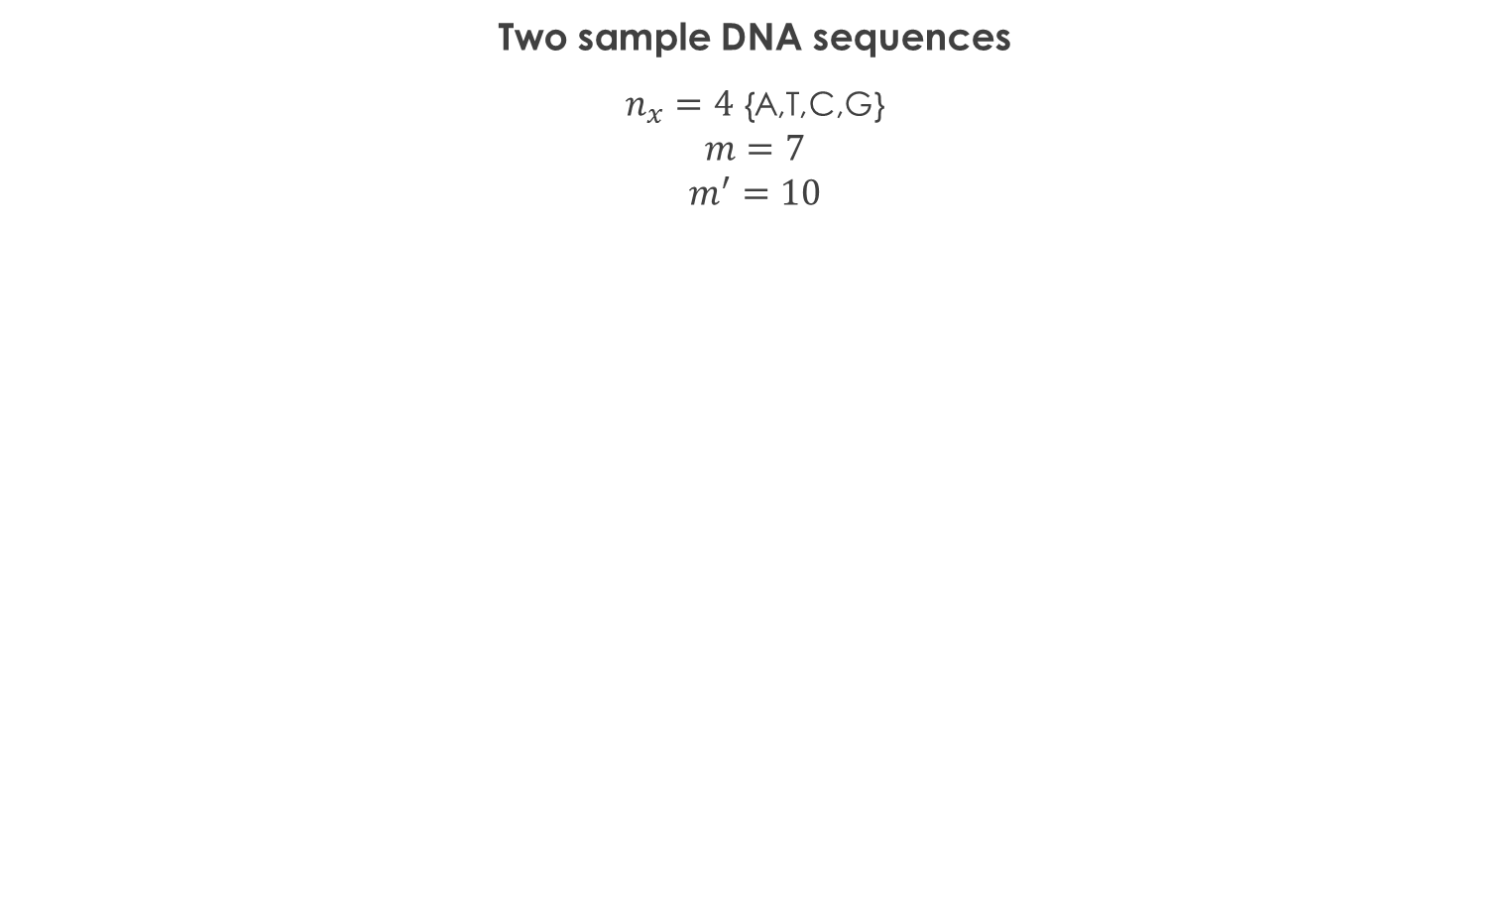
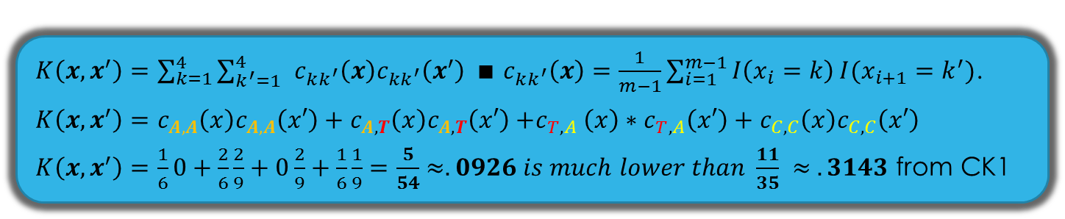
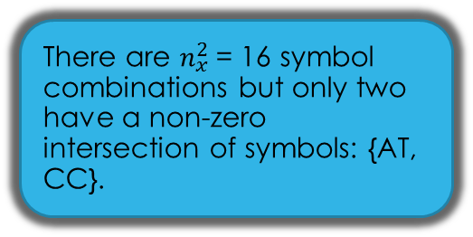

CK2 Exemplified
Two sample DNA sequences
$n_{x}=4$ {A,T,C,G} $$m=7$$
$$m^{′}=10$$
$$x=AATCCAT$$
$$x^{′}=ATACCGATTA$$
There are $n_{x}^{2}$= 16 symbol combinations but only two have a non-zero intersection of symbols: {AT, CC}.
1st order to 2nd order kernels increase how particular the sequence match needs to be.
$c_{A,A}\left(x\right)=\frac{1}{6}$, $c_{A,T}\left(x\right)=\frac{2}{6}$,
$c_{T,A}\left(x\right)=0$, $c_{C,C}\left(x\right)=\frac{1}{6}$
$c_{A,A}\left(x′\right)=0$, $c_{A,T}\left(x′\right)=\frac{2}{9}$,
$c_{T,A}\left(x′\right)=\frac{2}{9}$, $c_{C,C}\left(x′\right)=\frac{1}{9}$
$K\left(x,x^{′}\right)=\sum_{k=1}^{4}{\sum_{k^{′}=1}^{4}{ }c_{kk^{′}}\left(x\right)c_{kk^{′}}\left(x^{′}\right)} ∎$ $c_{kk^{′}}\left(x\right)=\frac{1}{m−1}\sum_{i=1}^{m−1}{I\left(x_{i}=k\right)}I(x_{i+1}=k^{′})$.
$$K\left(x,x^{′}\right)=c_{A,A}\left(x\right)c_{A,A}\left(x′\right)+c_{A,T}\left(x\right)c_{A,T}\left(x′\right){+c}_{T,A}\left(x\right)∗c_{T,A}\left(x′\right)+c_{C,C}\left(x\right)c_{C,C}\left(x′\right)$$
$K\left(x,x^{′}\right)=\frac{1}{6}0+\frac{2}{6}\frac{2}{9}+0\frac{2}{9}+\frac{1}{6}\frac{1}{9}=\frac{5}{54}$ $≈.0926 is much lower than \frac{11}{35} ≈ .3143$ from CK1

Slide 8
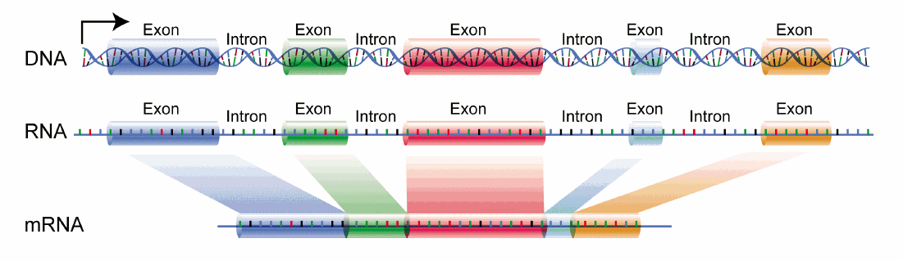
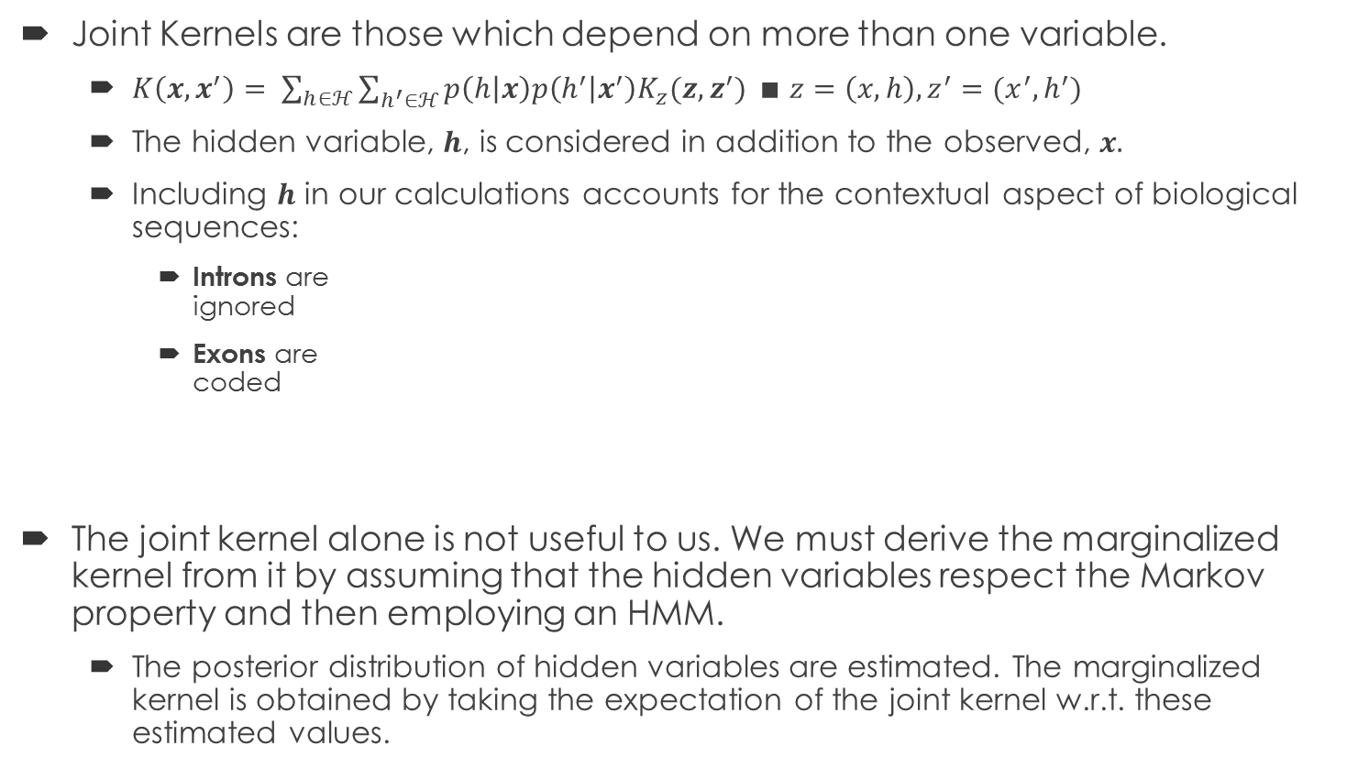
Joint Kernels and Marginalization
Joint Kernels are those which depend on more than one variable.
$K\left(x,x^{′}\right)= \sum_{h∈ℋ}{\sum_{h^{′}∈ℋ}{p\left(h | x\right)p\left(h^{′} | x^{′}\right)K_{z}(z,z^{′})}} ∎ z=\left(x,h\right), z^{′}=(x^{′},h^{′})$
The hidden variable, $h$, is considered in addition to the observed, $x.$
Including $h$ in our calculations accounts for the contextual aspect of biological sequences:
Introns are ignored
Exons are coded
The joint kernel alone is not useful to us. We must derive the marginalized kernel from it by assuming that the hidden variables respect the Markov property and then employing an HMM.
The posterior distribution of hidden variables are estimated. The marginalized kernel is obtained by taking the expectation of the joint kernel w.r.t. these estimated values.

Slide 9
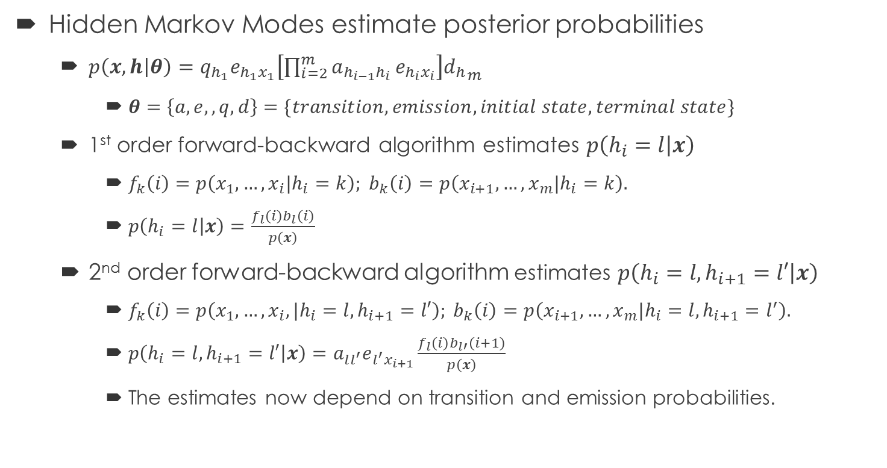
Hidden Markov Models
Hidden Markov Modes estimate posterior probabilities
$p\left(x,h | θ\right)=q_{h_{1}}e_{h_{1}x_{1}}\left[\prod_{i=2}^{m}{a_{h_{i−1}h_{i}}}e_{h_{i}x_{i}}\right]{d_{h}}_{m}$
$θ=\left\{a,e,,q,d\right\}=\{transition, emission, initial state, terminal state\}$
1st order forward-backward algorithm estimates $p\left(h_{i}=l | x\right)$
$f_{k}\left(i\right)=p\left(x_{1},…,x_{i}|h_{i}=k\right); b_{k}\left(i\right)=p\left(x_{i+1}, …, x_{m}|h_{i}=k\right).$
$p\left(h_{i}=l | x\right)=\frac{f_{l}\left(i\right)b_{l}\left(i\right)}{p\left(x\right)}$
2nd order forward-backward algorithm estimates $p\left(h_{i}=l, h_{i+1}=l′ | x\right)$
$f_{k}\left(i\right)=p\left(x_{1},…,x_{i},|h_{i}=l, h_{i+1}=l′\right); b_{k}\left(i\right)=p\left(x_{i+1}, …, x_{m}|h_{i}=l, h_{i+1}=l^{′}\right).$
$p\left(h_{i}=l, h_{i+1}=l′ | x\right)=a_{ll^{′}}e_{l^{′}x_{i+1}}\frac{f_{l}\left(i\right)b_{l′}\left(i+1\right)}{p\left(x\right)}$
The estimates now depend on transition and emission probabilities.

Slide 10
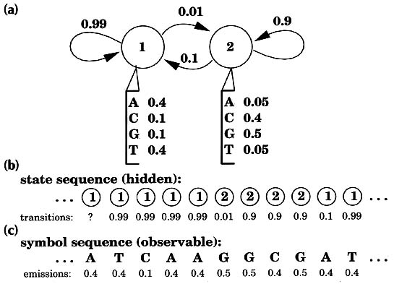
Hidden Markov Models exemplified
The transition probabilities are referring to the probability that the state switches between 1 or 2.
This affects the emission rate of each symbol
Only the emission probabilities can be observed.
But, they are dictated by the gives states, so the state can be inferred by using an HMM.

Slide 11
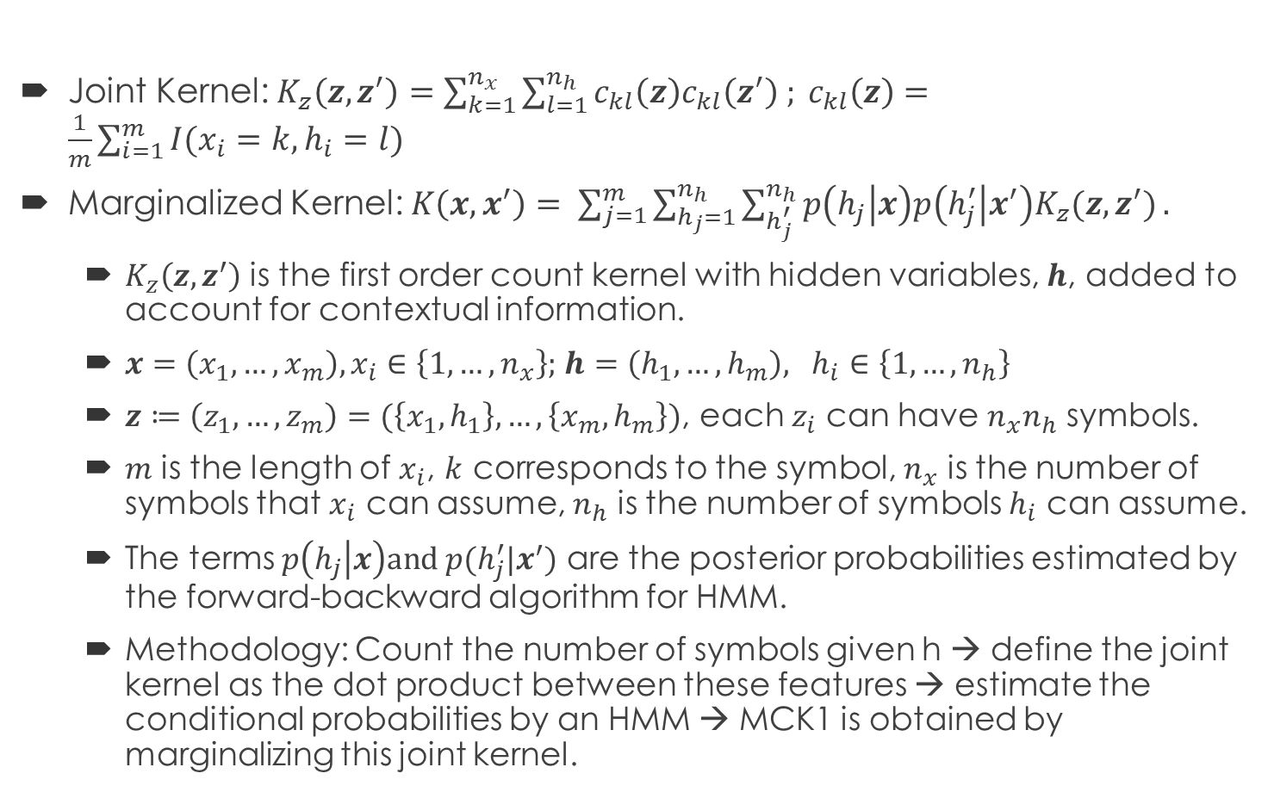
Kernels: Marginalized CK1 (MCK1)
Joint Kernel: $K_{z}\left(z,z^{′}\right)=\sum_{k=1}^{n_{x}}{\sum_{l=1}^{n_{h}}{c_{kl}\left(z\right)c_{kl}\left(z^{′}\right) ; }}c_{kl}\left(z\right)=\frac{1}{m}\sum_{i=1}^{m}{I(x_{i}=k, h_{i}=l)}$
Marginalized Kernel: $K\left(x,x^{′}\right)= \sum_{j=1}^{m}{\sum_{h_{j}=1}^{n_{h}}{\sum_{h_{j}^{′}}^{n_{h}}{p\left(h_{j} | x\right)p\left(h_{j}^{′} | x^{′}\right)K_{z}(z,z^{′})}}}.$
$K_{z}\left(z,z^{′}\right)$ is the first order count kernel with hidden variables, $h$, added to account for contextual information.
$x=\left(x_{1}, …,x_{m}\right), x_{i}∈\left\{1,…,n_{x}\right\};$ $h=\left(h_{1}, …,h_{m}\right), h_{i}∈\left\{1,…,n_{h}\right\}$
$z≔\left(z_{1},…,z_{m}\right)=(\left\{x_{1},h_{1}\right\},…,\left\{x_{m}, h_{m}\right\})$, each $z_{i}$ can have $n_{x}n_{h}$ symbols.
$m$ is the length of $x_{i}$, $k$ corresponds to the symbol, $n_{x}$ is the number of symbols that $x_{i}$ can assume, $n_{h}$ is the number of symbols $h_{i}$ can assume.
The terms $p\left(h_{j} | x\right)and p(h_{j}^{′}|x^{′})$ are the posterior probabilities estimated by the forward-backward algorithm for HMM.
Methodology: Count the number of symbols given h → define the joint kernel as the dot product between these features → estimate the conditional probabilities by an HMM → MCK1 is obtained by marginalizing this joint kernel.

Slide 12
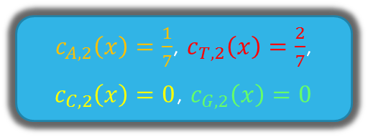
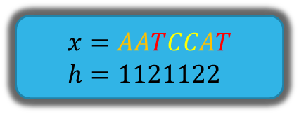
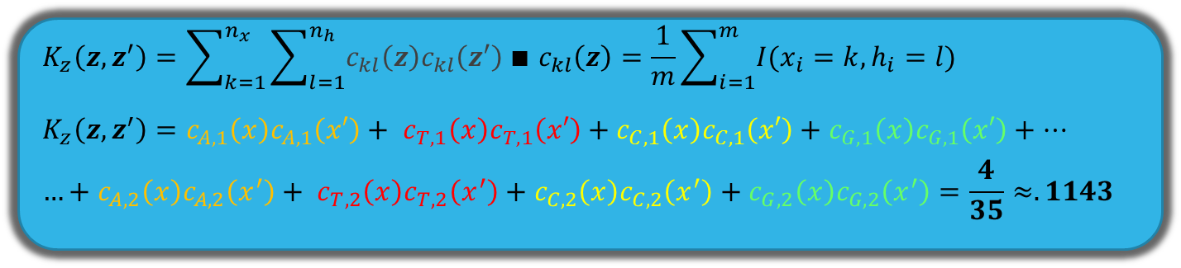
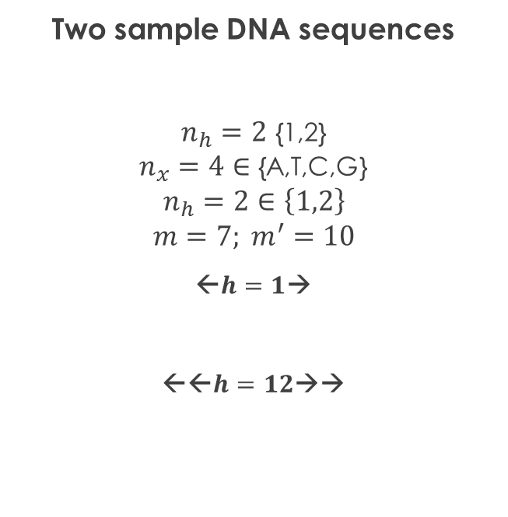
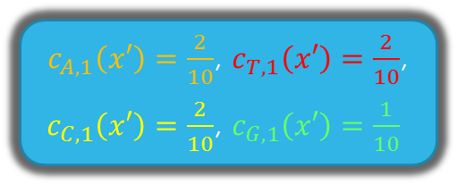
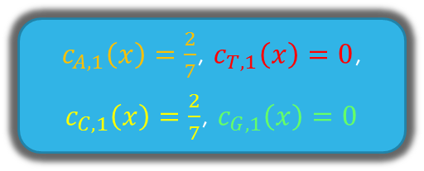
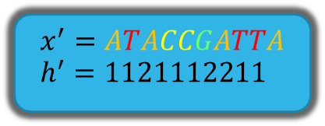
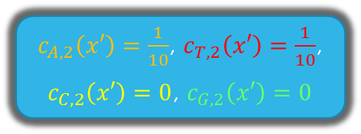
MCK1 Exemplified
Two sample DNA sequences
$n_{h}=2$ {1,2} $n_{x}=4∈$ {A,T,C,G}
$$n_{h}=2∈\left\{1,2\right\}$$
$$m=7; m^{′}=10$$
←$h=1$→
←←$h=12$→→
$$x=AATCCAT \\ h=1121122$$
$$x^{′}=ATACCGATTA \\ h^{′}=1121112211$$
$c_{A,1}\left(x\right)=\frac{2}{7}$, $c_{T,1}\left(x\right)=0$,
$c_{C,1}\left(x\right)=\frac{2}{7}$, $c_{G,1}\left(x\right)=0$
$c_{A,1}\left(x′\right)=\frac{2}{10}$, $c_{T,1}\left(x′\right)=\frac{2}{10}$,
$c_{C,1}\left(x′\right)=\frac{2}{10}$, $c_{G,1}\left(x′\right)=\frac{1}{10}$
$c_{A,2}\left(x\right)=\frac{1}{7}$, $c_{T,2}\left(x\right)=\frac{2}{7}$,
$c_{C,2}\left(x\right)=0$, $c_{G,2}\left(x\right)=0$
$c_{A,2}\left(x′\right)=\frac{1}{10}$, $c_{T,2}\left(x′\right)=\frac{1}{10}$,
$c_{C,2}\left(x′\right)=0$, $c_{G,2}\left(x′\right)=0$
$$K_{z}\left(z,z^{′}\right)=\sum_{k=1}^{n_{x}}{\sum_{l=1}^{n_{h}}{c_{kl}\left(z\right)c_{kl}\left(z^{′}\right)}}∎ c_{kl}\left(z\right)=\frac{1}{m}\sum_{i=1}^{m}{I(x_{i}=k, h_{i}=l)}$$
$$K_{z}\left(z,z^{′}\right)=c_{A,1}\left(x\right)c_{A,1}\left(x′\right)+ c_{T,1}\left(x\right)c_{T,1}\left(x′\right)+c_{C,1}\left(x\right)c_{C,1}\left(x′\right)+c_{G,1}\left(x\right)c_{G,1}\left(x′\right)+…$$
$$…+c_{A,2}\left(x\right)c_{A,2}\left(x^{′}\right)+ c_{T,2}\left(x\right)c_{T,2}\left(x^{′}\right)+c_{C,2}\left(x\right)c_{C,2}\left(x^{′}\right)+c_{G,2}\left(x\right)c_{G,2}\left(x^{′}\right)=\frac{4}{35}≈.1143$$

Slide 13
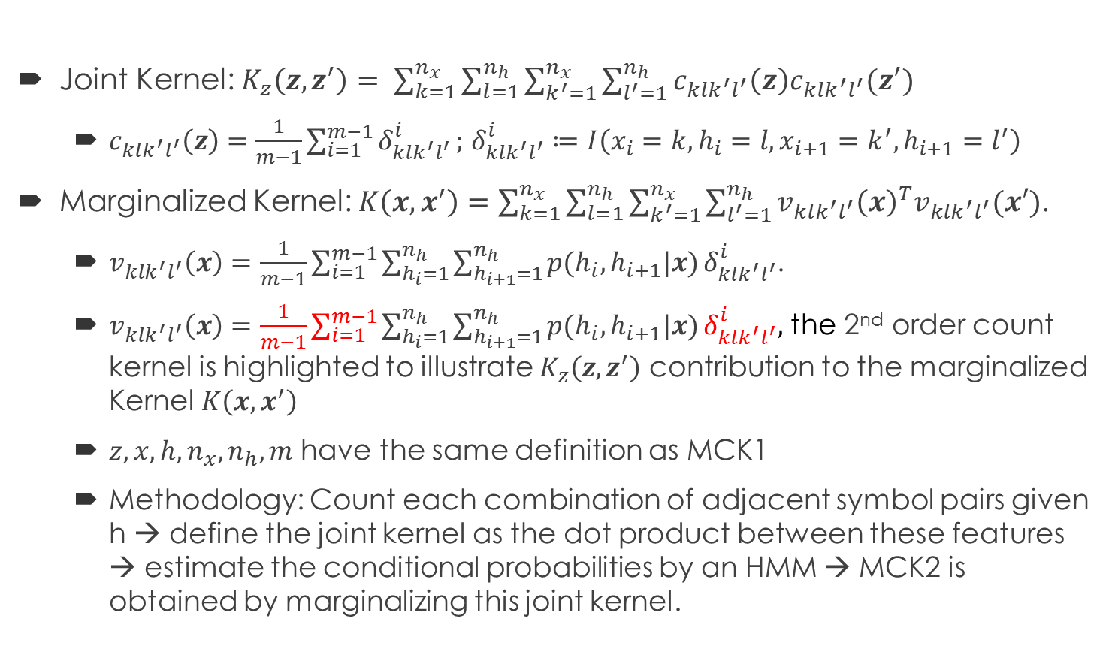
Kernels: Marginalized CK2 (MCK2)
Joint Kernel: $K_{z}\left(z,z^{′}\right)= \sum_{k=1}^{n_{x}}{\sum_{l=1}^{n_{h}}{\sum_{k^{′}=1}^{n_{x}}{\sum_{l^{′}=1}^{n_{h}}{c_{klk^{′}l^{′}}\left(z\right)c_{klk^{′}l^{′}}(z^{′})}}}}$
$c_{klk^{′}l^{′}}\left(z\right)=\frac{1}{m−1}\sum_{i=1}^{m−1}{δ_{klk^{′}l^{′}}^{i}};$ $δ_{klk^{′}l^{′}}^{i}≔I\left(x_{i}=k, h_{i}=l, x_{i+1}=k^{′}, h_{i+1}=l^{′}\right)$
Marginalized Kernel: $K\left(x,x^{′}\right)=\sum_{k=1}^{n_{x}}{\sum_{l=1}^{n_{h}}{\sum_{k^{′}=1}^{n_{x}}{\sum_{l^{′}=1}^{n_{h}}{v_{klk^{′}l^{′}}{\left(x\right)}^{T}v_{klk^{′}l^{′}}(x′)}}}}$.
$v_{klk^{′}l^{′}}\left(x\right)=\frac{1}{m−1}\sum_{i=1}^{m−1}{\sum_{h_{i}=1}^{n_{h}}{\sum_{h_{i+1}=1}^{n_{h}}{p(h_{i}, h_{i+1}|x)}}}δ_{klk^{′}l^{′}}^{i}$.
$v_{klk^{′}l^{′}}\left(x\right)=\frac{1}{m−1}\sum_{i=1}^{m−1}{\sum_{h_{i}=1}^{n_{h}}{\sum_{h_{i+1}=1}^{n_{h}}{p(h_{i}, h_{i+1}|x)}}}δ_{klk^{′}l^{′}}^{i},$ the 2nd order count kernel is highlighted to illustrate $K_{z}\left(z,z^{′}\right)$ contribution to the marginalized Kernel $K\left(x,x^{′}\right)$
$z, x, h, n_{x}, n_{h}, m$ have the same definition as MCK1
Methodology: Count each combination of adjacent symbol pairs given h → define the joint kernel as the dot product between these features → estimate the conditional probabilities by an HMM → MCK2 is obtained by marginalizing this joint kernel.

Slide 14
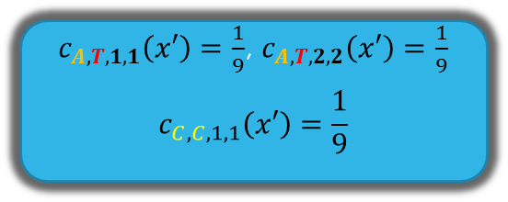
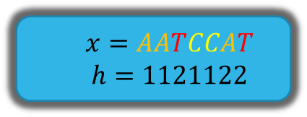
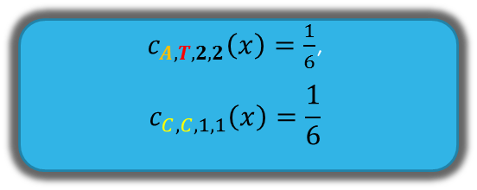
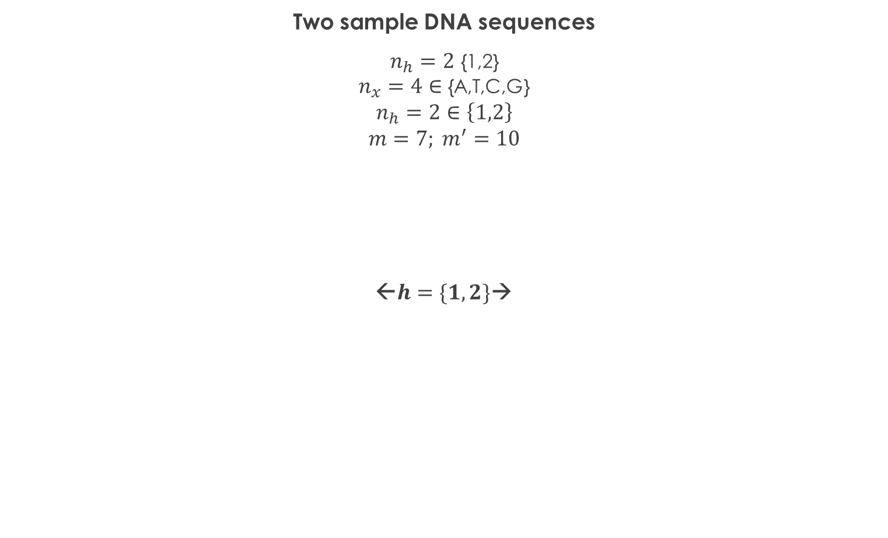
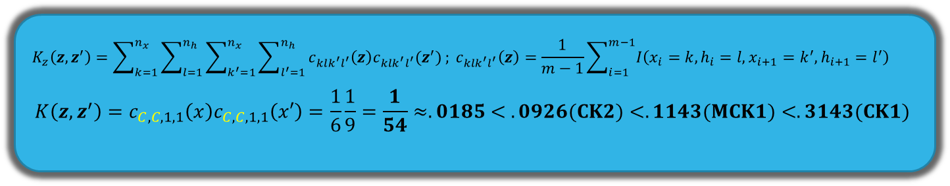
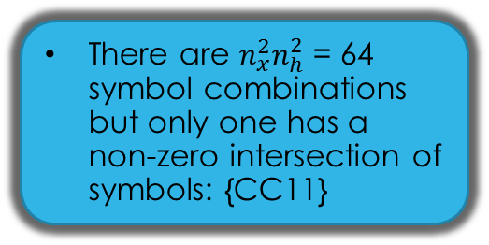
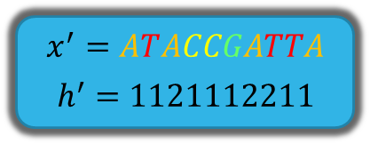
MCK2 Exemplified
Two sample DNA sequences
$n_{h}=2$ {1,2} $n_{x}=4∈$ {A,T,C,G}
$$n_{h}=2∈\left\{1,2\right\}$$
$$m=7; m^{′}=10$$
←$h=\{1,2\}$→
$$x=AATCCAT$$
$$h=1121122$$
$$x^{′}=ATACCGATTA$$
$$h^{′}=1121112211$$
There are $n_{x}^{2}n_{h}^{2}$= 64 symbol combinations but only one has a non-zero intersection of symbols: {CC11}
1st order to 2nd order and Singular to Joint Kernels both
$c_{A,T,2,2}\left(x\right)=\frac{1}{6}$,
$$c_{C,C,1,1}\left(x\right)=\frac{1}{6}$$
$c_{A,T,1,1}\left(x′\right)=\frac{1}{9}$, $c_{A,T,2,2}\left(x′\right)=\frac{1}{9}$
$$c_{C,C,1,1}\left(x′\right)=\frac{1}{9}$$
$$K_{z}\left(z,z^{′}\right)=\sum_{k=1}^{n_{x}}{\sum_{l=1}^{n_{h}}{\sum_{k^{′}=1}^{n_{x}}{\sum_{l^{′}=1}^{n_{h}}{c_{klk^{′}l^{′}}\left(z\right)c_{klk^{′}l^{′}}(z^{′})}}}}; c_{klk^{′}l^{′}}\left(z\right)=\frac{1}{m−1}\sum_{i=1}^{m−1}{I\left(x_{i}=k, h_{i}=l, x_{i+1}=k^{′}, h_{i+1}=l^{′}\right)}$$
$$K\left(z,z^{′}\right)=c_{C,C,1,1}\left(x\right)c_{C,C,1,1}\left(x′\right)=\frac{1}{6}\frac{1}{9}=\frac{1}{54}≈.0185< .0926(CK2)<.1143(MCK1)<.3143(CK1)$$

Slide 15
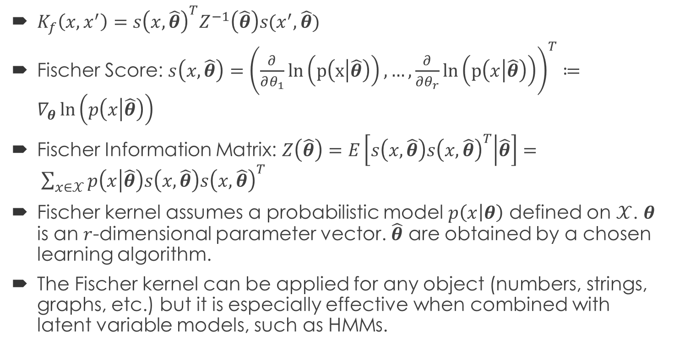
Kernels: Fischer Kernel (FK)
$K_{f}\left(x,x^{′}\right)=s{\left(x, \hat{θ}\right)}^{T}Z^{−1}\left(\hat{θ}\right)s(x^{′},\hat{θ})$
Fischer Score: $s\left(x,\hat{θ}\right)={\left(\frac{∂}{∂θ_{1}}ln\left(p\left(x | \hat{θ}\right)\right),…,\frac{∂}{∂θ_{r}}ln\left(p\left(x | \hat{θ}\right)\right)\right)}^{T}≔∇_{θ}\ln\left(p\left(x | \hat{θ}\right)\right)$
Fischer Information Matrix: $Z\left(\hat{θ}\right)=E\left[s\left(x,\hat{θ}\right)s{\left(x,\hat{θ}\right)}^{T} | \hat{θ}\right]= \sum_{x∈𝒳}{p\left(x | \hat{θ}\right)s\left(x,\hat{θ}\right)s{\left(x,\hat{θ}\right)}^{T}}$
Fischer kernel assumes a probabilistic model $p\left(x | θ\right)$ defined on $𝒳$. $θ$ is an $r$-dimensional parameter vector. $\hat{θ}$ are obtained by a chosen learning algorithm.
The Fischer kernel can be applied for any object (numbers, strings, graphs, etc.) but it is especially effective when combined with latent variable models, such as HMMs.

Slide 16
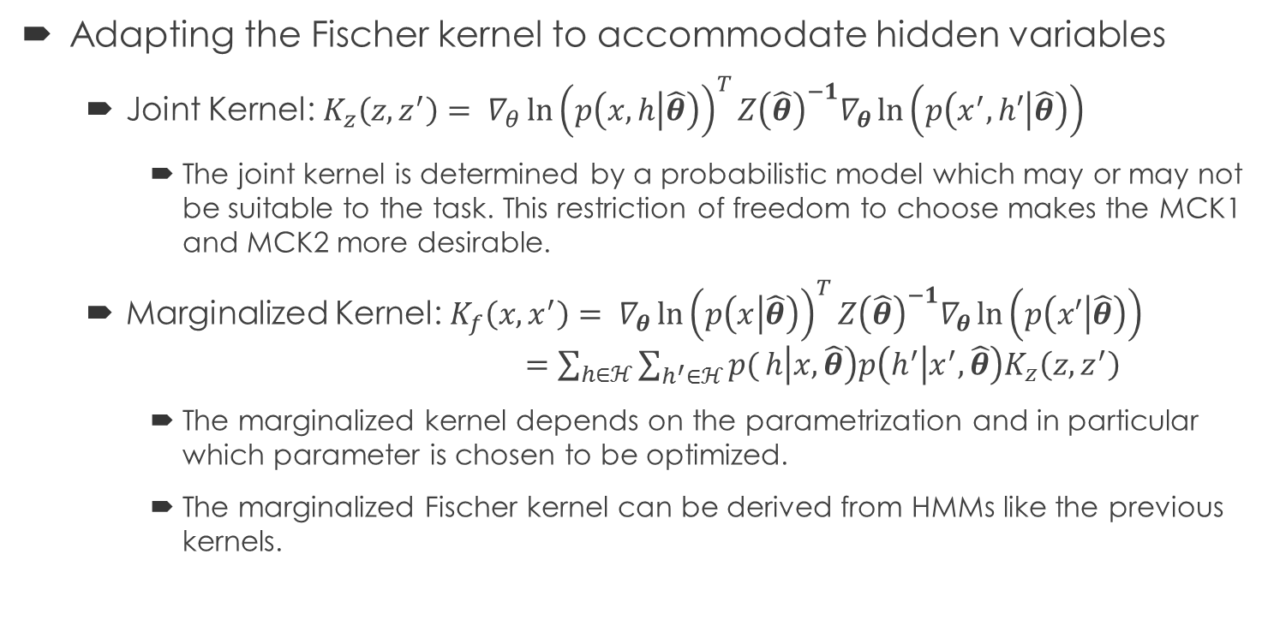
Fischer Kernel with hidden variables
Adapting the Fischer kernel to accommodate hidden variables
Joint Kernel: $K_{z}\left(z,z^{′}\right)= {∇_{θ}\ln\left(p\left(x,h | \hat{θ}\right)\right)}^{T}Z{\left(\hat{θ}\right)}^{−1}∇_{θ}\ln\left(p\left(x^{′},h′ | \hat{θ}\right)\right)$
The joint kernel is determined by a probabilistic model which may or may not be suitable to the task. This restriction of freedom to choose makes the MCK1 and MCK2 more desirable.
Marginalized Kernel: ${K_{f}\left(x,x^{′}\right)= ∇}_{θ}{\ln\left(p\left(x | \hat{θ}\right)\right)}^{T}Z{\left(\hat{θ}\right)}^{−1}∇_{θ}\ln\left(p\left(x′ | \hat{θ}\right)\right)$ $=\sum_{h∈ℋ}{\sum_{h^{′}∈ℋ}{p(}}h\left|x, \hat{θ}\right)p\left(h^{′} | x^{′},\hat{θ}\right)K_{z}\left(z,z^{′}\right)$
The marginalized kernel depends on the parametrization and in particular which parameter is chosen to be optimized.
The marginalized Fischer kernel can be derived from HMMs like the previous kernels.

Slide 17
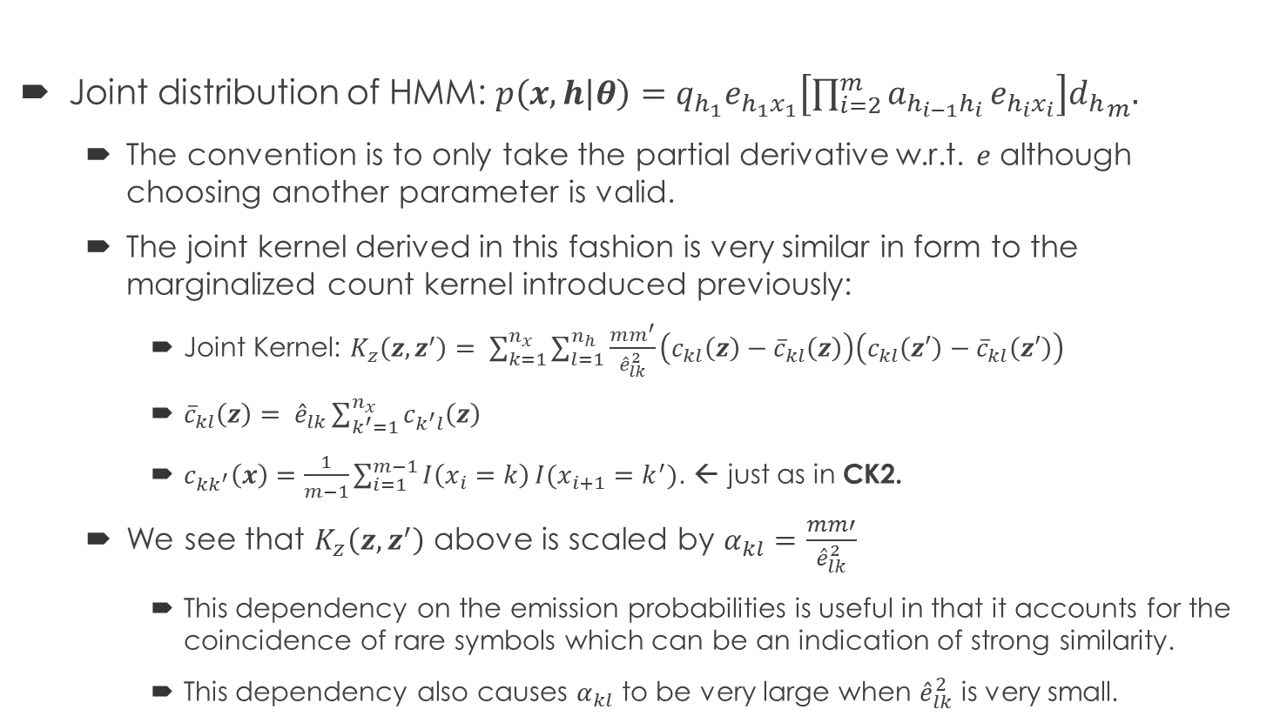
Marginalized Fischer Kernel by the Hidden Markov Model
Joint distribution of HMM: $p\left(x,h | θ\right)=q_{h_{1}}e_{h_{1}x_{1}}\left[\prod_{i=2}^{m}{a_{h_{i−1}h_{i}}}e_{h_{i}x_{i}}\right]{d_{h}}_{m}.$
The convention is to only take the partial derivative w.r.t. $e$ although choosing another parameter is valid.
The joint kernel derived in this fashion is very similar in form to the marginalized count kernel introduced previously:
Joint Kernel: $K_{z}\left(z, z^{′}\right)= \sum_{k=1}^{n_{x}}{\sum_{l=1}^{n_{h}}{\frac{mm^{′}}{{\hat{e}}_{lk}^{2}}}}\left(c_{kl}\left(z\right)−{\overline{c}}_{kl}\left(z\right)\right)\left(c_{kl}\left(z′\right)−{\overline{c}}_{kl}\left(z′\right)\right)$
${\overline{c}}_{kl}\left(z\right)= {\hat{e}}_{lk}\sum_{k^{′}=1}^{n_{x}}{c_{k^{′}l}\left(z\right) }$
$c_{kk^{′}}\left(x\right)=\frac{1}{m−1}\sum_{i=1}^{m−1}{I\left(x_{i}=k\right)}I(x_{i+1}=k^{′})$. ← just as in CK2.
We see that $K_{z}\left(z, z^{′}\right)$ above is scaled by $α_{kl}=\frac{mm′}{{\hat{e}}_{lk}^{2}}$
This dependency on the emission probabilities is useful in that it accounts for the coincidence of rare symbols which can be an indication of strong similarity.
This dependency also causes $α_{kl}$ to be very large when ${\hat{e}}_{lk}^{2}$ is very small.

Slide 18
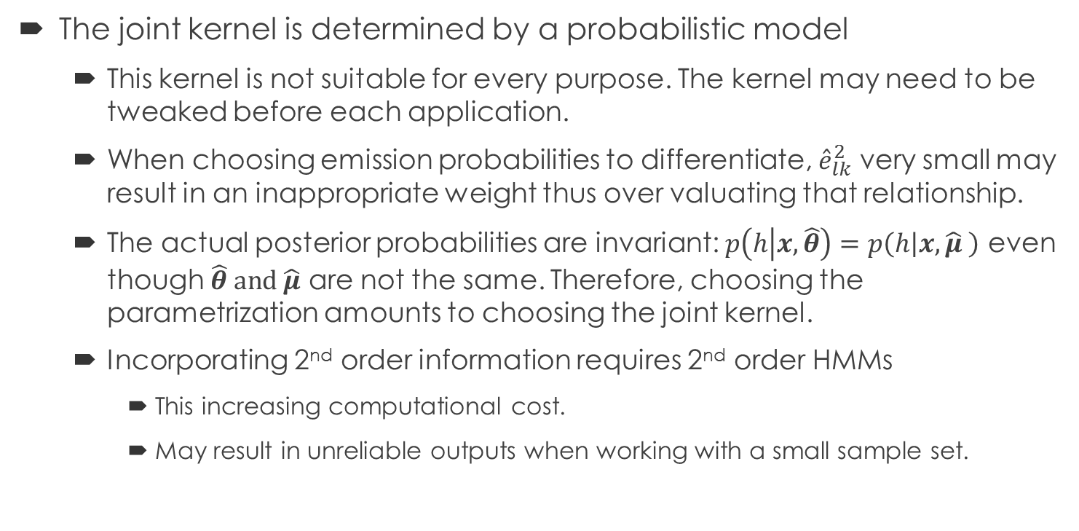
Fischer Kernel Deficiencies
The joint kernel is determined by a probabilistic model
This kernel is not suitable for every purpose. The kernel may need to be tweaked before each application.
When choosing emission probabilities to differentiate, ${\hat{e}}_{lk}^{2}$ very small may result in an inappropriate weight thus over valuating that relationship.
The actual posterior probabilities are invariant: $p\left(h | x,\hat{θ}\right)=p\left(h | x,\hat{μ} \right)$ even though $\hat{θ} and \hat{μ}$ are not the same. Therefore, choosing the parametrization amounts to choosing the joint kernel.
Incorporating 2nd order information requires 2nd order HMMs
This increasing computational cost.
May result in unreliable outputs when working with a small sample set.

Slide 19
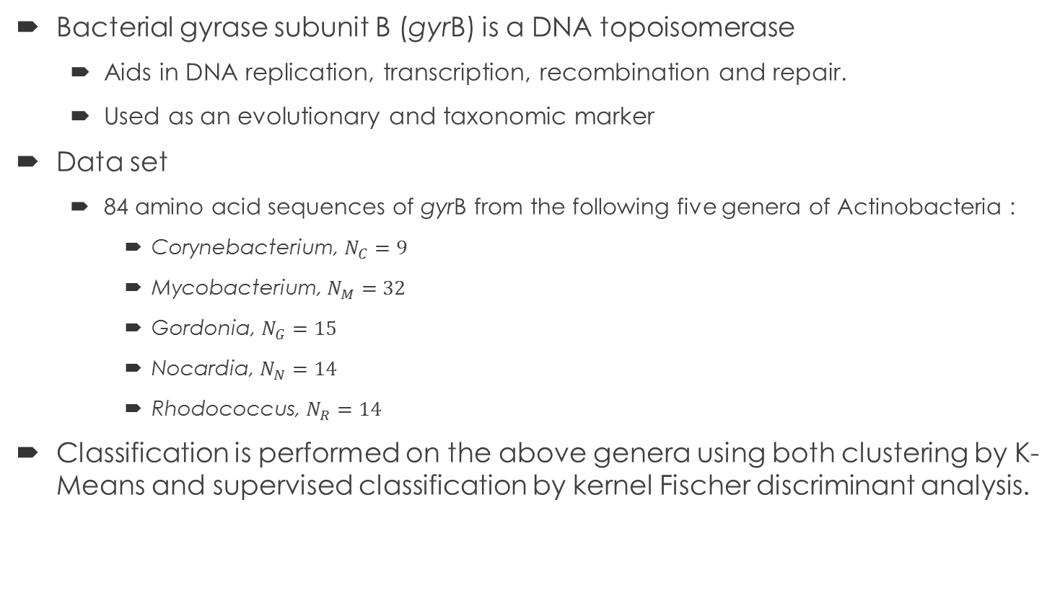
Experimental Results
Bacterial gyrase subunit B (gyrB) is a DNA topoisomerase
Aids in DNA replication, transcription, recombination and repair.
Used as an evolutionary and taxonomic marker
Data set
84 amino acid sequences of gyrB from the following five genera of Actinobacteria :
Corynebacterium, $N_{C}=9$
Mycobacterium, $N_{M}=32$
Gordonia, $N_{G}=15$
Nocardia, $N_{N}=14$
Rhodococcus, $N_{R}=14$
Classification is performed on the above genera using both clustering by K-Means and supervised classification by kernel Fischer discriminant analysis.

Slide 20
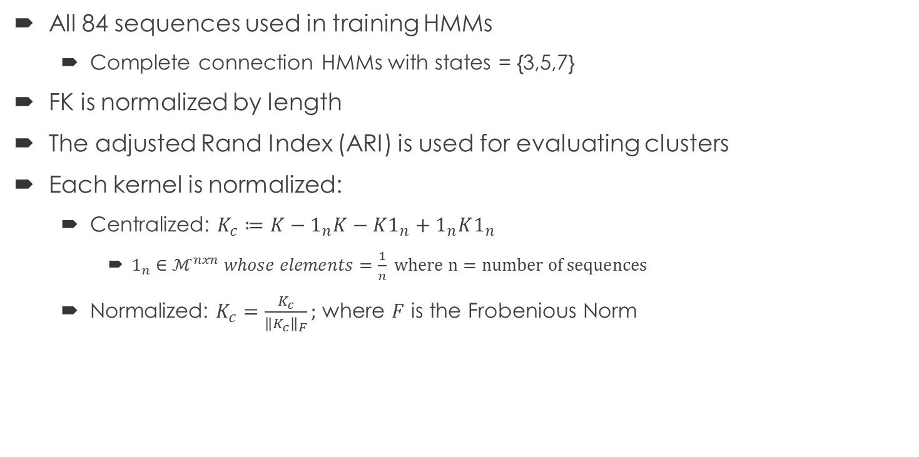
Experimental Result: K-Clustering
All 84 sequences used in training HMMs
Complete connection HMMs with states = {3,5,7}
FK is normalized by length
The adjusted Rand Index (ARI) is used for evaluating clusters
Each kernel is normalized:
Centralized: $K_{c}≔K−1_{n}K−K1_{n}+1_{n}K1_{n}$
$1_{n}∈ℳ^{nxn} whose elements=\frac{1}{n} where n=number of sequences$
Normalized: $K_{c}=\frac{K_{c}}{{\left\|K_{c}\right\|}_{F}};$ where $F$ is the Frobenious Norm

Slide 21
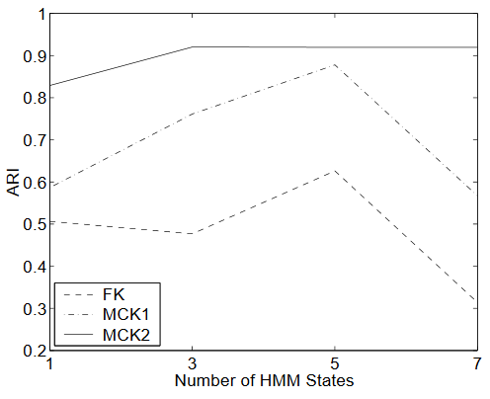
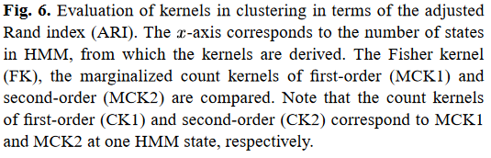
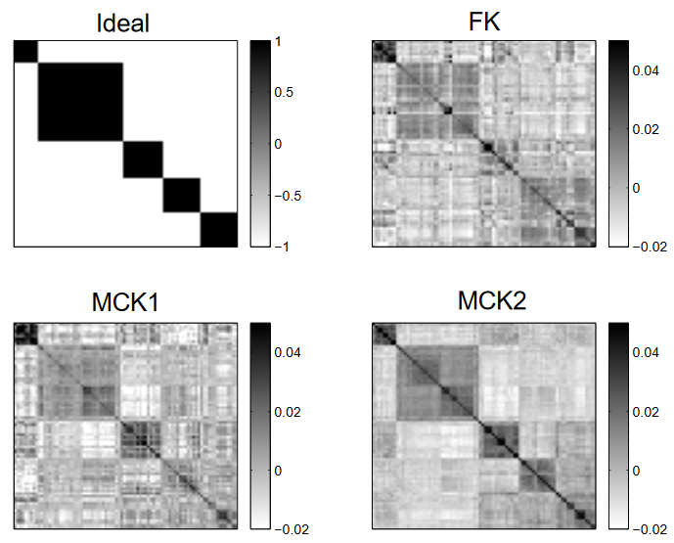
K Clustering visualized
MCK2 captures more with less complexity.

Slide 22
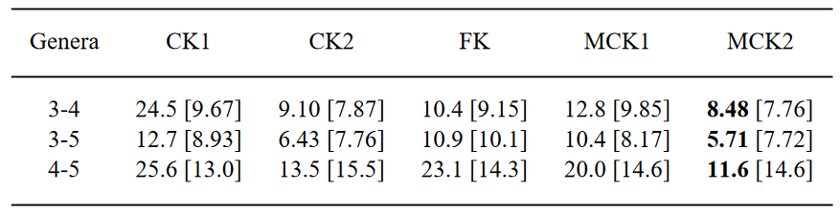
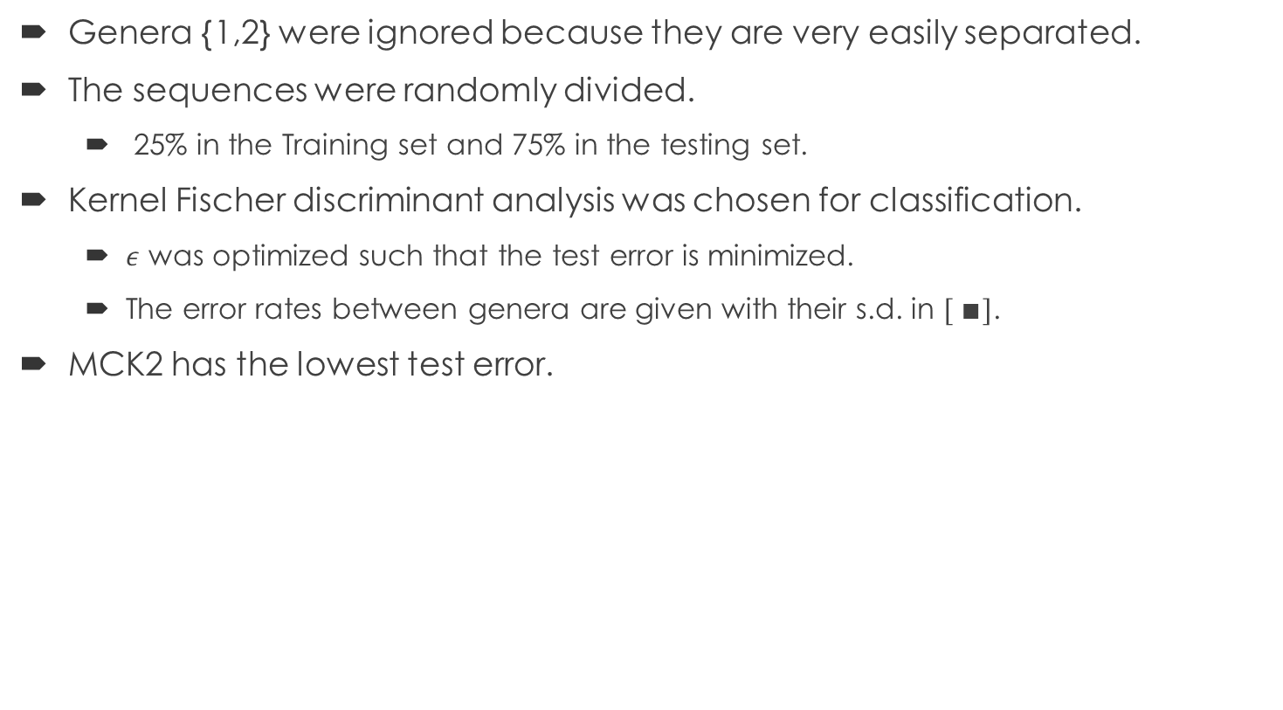
Experimental Result: kernel Fischer discriminant analysis
Genera {1,2} were ignored because they are very easily separated.
The sequences were randomly divided.
25% in the Training set and 75% in the testing set.
Kernel Fischer discriminant analysis was chosen for classification.
$ε$ was optimized such that the test error is minimized.
The error rates between genera are given with their s.d. in $[ ∎]$.
MCK2 has the lowest test error.

Slide 23
Future improvements
Improvements that could have been made
Including the training error rates to see how well the methods generalize.
Increase the number of specimens for a larger training set.
Explaining the implications of removing the Fischer information matrix when deriving the Fischer kernel from HMMs.
Future experiments can include
Trying different kernel methods for classification, SVMs for instance.
Taking the gradient of different parameters when building the Fischer Kernel.
Run the experiment on a group of different organisms altogether.
Increase the order of the count kernel beyond two.
Tinker with counting the sequences by a different scheme.
Every other
Every third
…

